Slide 1
Uncovering Bias and Ensuring Fairness: A
Comprehensive Analysis of the COMPAS
Algorithm
Project By:
Dev Divyendh Dhinakaran [G01450299] and Sai Abhishek Nemani [G01462099]
College of Engineering and Computing
George Mason University

Slide 2


THE COMPAS ALGORITHM
COMPAS, which stands for Correctional Offender Management Profiling for Alternative Sanctions
COMPAS - A risk assessment tool used in the criminal justice system.
It aims to predict the likelihood of a defendant reoffending or failing to appear in court based
on various factors.

Slide 3


CONTROVERSIES AND CRITICISMS
COMPAS has faced criticism for potential bias, as some studies suggest that it may disproportionately classify certain demographic groups as higher risk.
The algorithm's transparency and fairness have been subjects of debate, raising ethical concerns in its application within the criminal justice system.

Slide 4

PROBLEM STATEMENT: MITIGATING BIAS IN COMPAS ALGORITHM
The COMPAS algorithm, utilized for risk assessment in the criminal justice system, has been under scrutiny for its potential to introduce biases that impact the fairness of legal decisions.
Existing studies have identified disparities in the COMPAS algorithm's predictions, particularly with regard to demographic variables such as age, race, gender, and prior criminal history.
These biases raise concerns about the just and unbiased treatment of individuals within the criminal justice system.
Our project addresses the critical need to mitigate and rectify these biases, enhancing the reliability and equity of risk assessments.

Slide 5

THE WORK FLOW
01
02
03
04
05
Literature Review and Critical Analysis
Cleaning and Preprocessing the Data
Analyzing and Correlating the Bias
Mitigating Bias
The Model

Slide 6


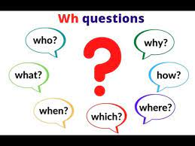
Literature Review and Critical Analysis
Previous Studies
Previous Experiments
Analyse the drawback in the algorithm
WHY, WHERE, WHEN, HOW the COMPAS is used

Slide 7


DATA CLEANING AND PREPROCESSING
Data Cleaning
Removing Null values
Re-shaping the dataset
Analysis of 5 number summary
Dropping columns
Feature Manipulation
Feature Reduction
Feature Extraction
Explicit Categorical to Numerical Value Conversion (grouping data)
Further Processing
Scaling the values (min-max scaling)
Encoding

Slide 8
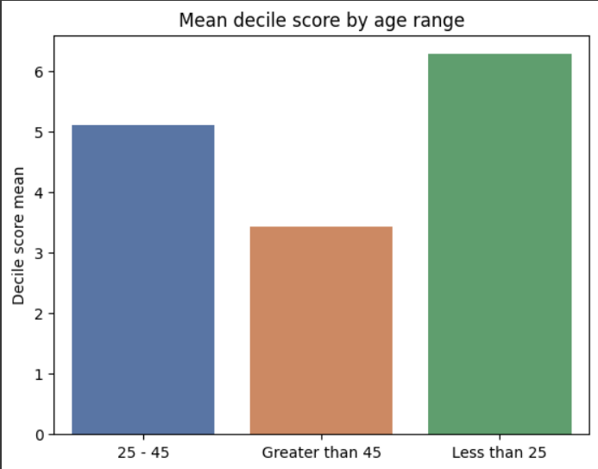
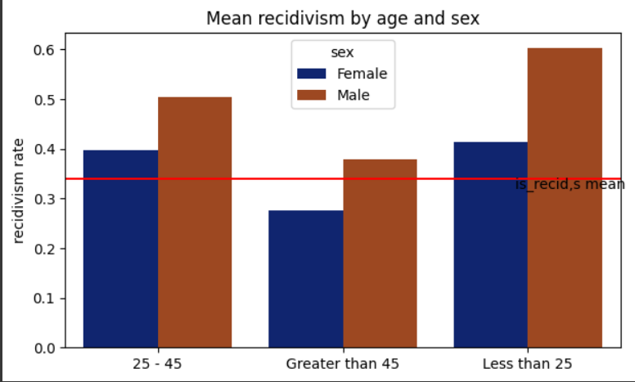
Analyzing and Correlating the Bias

Slide 9
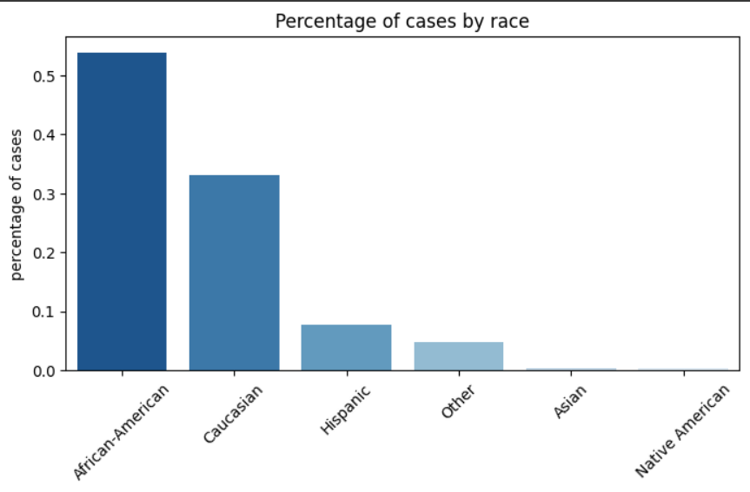
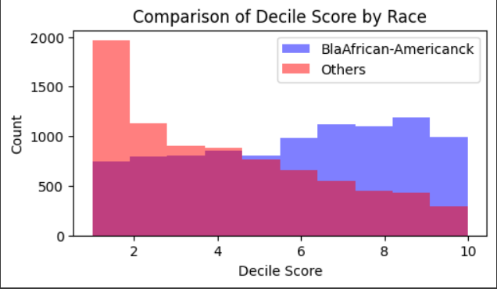
Analyzing and Correlating the Bias

Slide 10
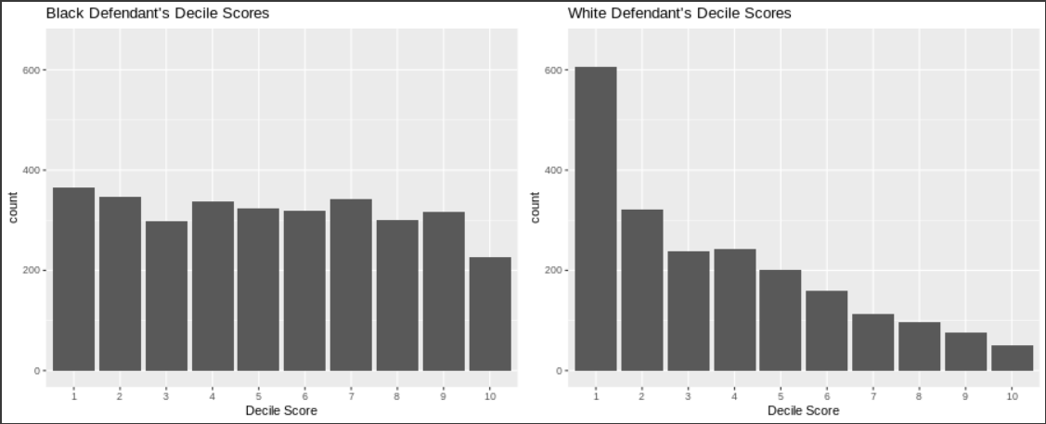
Analyzing and Correlating the Bias

Slide 11
MITIGATING BIAS
RESAMPLING
FAIRLEARN MODULE
Over Sampling
Exponential Gradient
Demographic Parity
Random Over Sampler

Slide 12
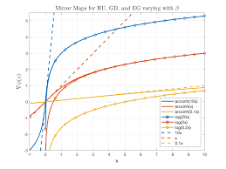
FAIR LEARN
EXPONENTIAL GRADIENT REDUCTION
An open-source Python library developed by Microsoft
Focuses on fairness in machine learning models.
Provides tools and techniques to assess and address bias and unfairness in predictive models
A fairness-aware machine learning technique that operates by modifying an existing machine learning model to achieve better fairness outcomes
Objective Function:
[ LOSS FUNCTION + FAIRNESS PENALITY]
Loss Function – ACCURACY
Penalty Term – FAIRNESS
Balancing Trade-offs:
The Exponentiated Gradient Reduction strikes a balance between optimizing for accuracy and promoting fairness.
By adjusting the weights assigned to instances, the algorithm seeks to minimize prediction errors while simultaneously reducing disparities in predictions across sensitive groups.

Slide 13
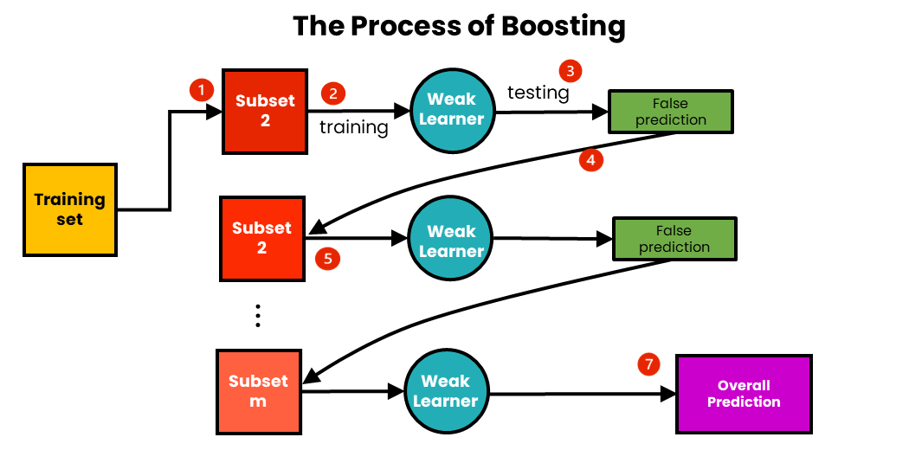
THE MODEL
RESAMPLING AND FAIRNESS MODEL
RANDOM FOREST
ENSEMBLE TECHNIQUE [BOOSTING]
Cross Validation
Gradient Boost
Random Over Sampler
Demographic Parity
Exponential Gradient
Estimator – Random Forest
Cross Validation
Hyper Parameter Tuning
Best Parameters
K [5] fold validation
Metric Analysis

Slide 14
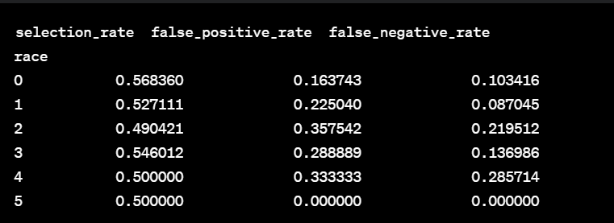
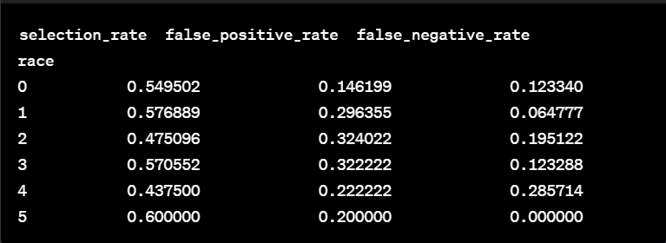
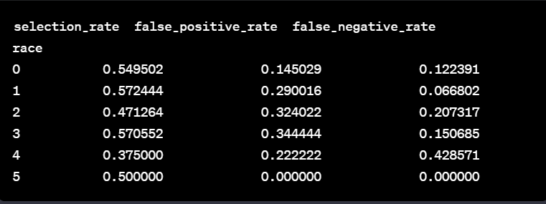
RESULTS
Baseline Random Forest
Modified RF - Hyper Parameter Tuning
01
02
.
Fairness Module with HPT RF - GBoost
Predictive Modeling
03
04
Selection Rate:
• Race 0: 54.95%
• Race 1: 57.24%
• Race 2:47.13%
• Race 3:57.06%
• Race 4: 37.50%
• Race 5: 50.00%
Accuracy: 0.8742
Precision: 0.88
Recall: 0.86
F1 Score: 0.87

Slide 15
CONCLUSION
In our study, we used a two-fold strategy to enhance predictive models for algorithmic decision-making.
We leveraged Random Forests and introduced boosting through Gradient Boosting for refined predictions.
These steps improved both predictive accuracy and provided a robust foundation for addressing inherent biases.
Employing fairlearn reduction with Exponentiated Gradient and Demographic Parity further mitigated bias, showcasing improved fairness in our algorithms.

Slide 16

ANY Questions ?

Slide 17
THANK YOU

